Slide 1
Capstone Project EDA Airbnb Bookings Analysis

Slide 2
Introduction.
Since 2008, guests and hosts have used Airbnb to expand on traveling possibilities and present a more unique, personalized way of experiencing the world.
Today, Airbnb became one of a kind service that is used and recognized by the whole world.
Data analysis on millions of listings provided through Airbnb is a crucial factor for the company.
These millions of listings generate a lot of data - data that can be analyzed and used for security, business decisions, understanding of customers' and providers' (hosts) behavior and performance on the platform, guiding marketing initiatives, implementation of innovative additional services and much more.

Slide 3
General overview of dataset.
This dataset has around is mix between categorical and numeric values.
Price is a dependent column.
Total 16 columns are present in the dataset.
Total observations are 48895.
Min of Price variable is 0, max is 10000$.
Mean price is 152$
On an average people stay 7 days in a room.
75 Percentage of times minimun neights stayed is 5.
Mean reviews given to Room/apartment is 23.

Slide 4
Missing value Handling.
‘name’ = 16 null values.
‘host_name’ = 21.
‘last_review’ = 10052.
‘reviews_per_month’ = 10052
‘name’ column we will replaced the ‘nan’ values with corresponding ‘room_type’ values.
‘host_name’ will not use as those are names of individuals.
'reviews_per_month' we will replace with 0 for NA values.
In ‘last_review’ We will convert its data type to catogorical and replace 'NA' with 'never'.

Slide 5
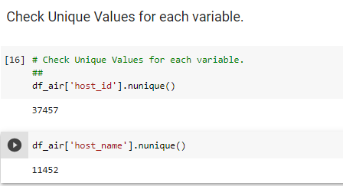
Here we had check unique value in Host_Id (37457) and Host_Name(11452). Which is different ,so it is difficult to analysis.

Slide 6
So we can clearly notice that availability column is having minimum values as well as 25th percentile is 0. So that seem awkward because having availability days 0 for 36% of data is bit shocking, If you have a business of providing shelter for AirBnb your availability is 0 days that is extreme case and extreme case is obviously shocking when it come 36% of data is having extreme case. But its not practically to exactly detect which apartment are having really availability 0 days so we will not alter this column as if we try to alter we can end up manipulating apartment which are really mostly busu(i.e 0 no. days availability)
we can also clearly see that minimum price is 0, which is surprising as price 0 doesn't make any sense to do business

Slide 7
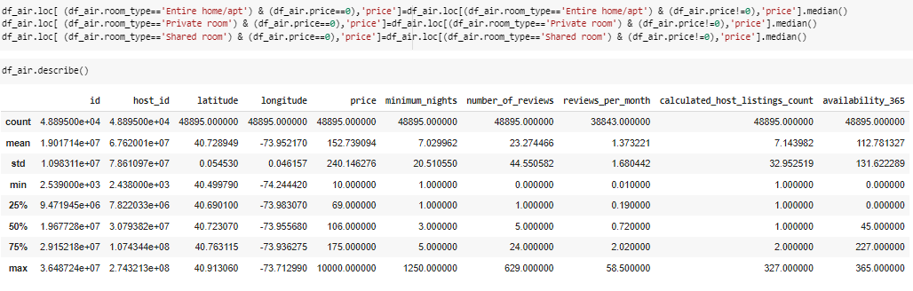
Lets fill these data with appropriate price value(By filling the price with median price for each room type)
NOTE: We can notice that we have successfully updated the price column where we have values as 0,we successfully updated the value with respective price value

Slide 8
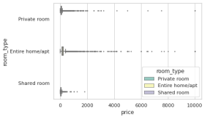
How the price column is distributed over room type and are there any surprising item in price column?
Observations:-
We can notice that there are many outliers for price in each of the room type category, so lets just why there is so high price or what else we can conclude for host have highest price for the rooms.

Slide 9
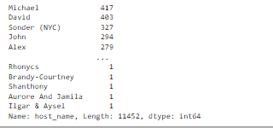
From this we can see that host name michael its appearing 417 time in the host_name column, so this might imply that michael is having highest number of room,but from the host_id column its showing heighest appearance of any host_id is 327, so this clearly implies that there can be multiple may have same name that's why we are we are getting different highest appearance in host_name as compared to host_id.
Lets check which host_name is actually having heighest number of apartments

Slide 10
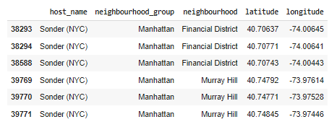
So sonder (NYC) is having maximum number of rooms for the guest, for Airbnb he might be very important person.
Sonder(NYC) is having multiple apartment in same building in different neighborhood

Slide 11
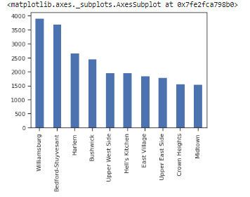
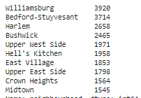
Which are the top 10 neighborhoods which are having maximum number of apartments for Airbnb?

Slide 12
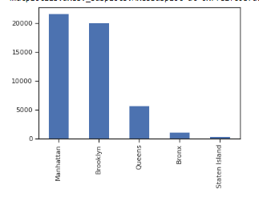

What are the neighborhood in each group which are having maximum price in their respective neighbourhood_group ?

Slide 13
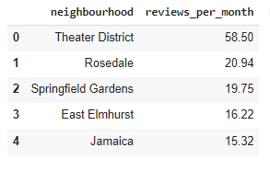
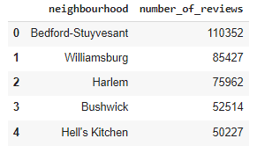
How neighborhood is relaed with reviews?
Top 5 Neighborhoods is having highest number of views

Slide 14
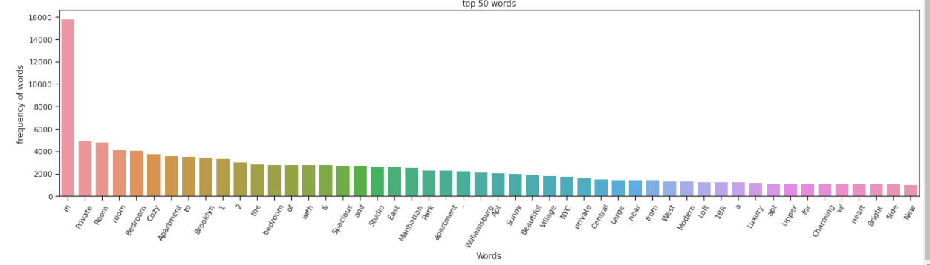
Top 50 words form Word_Cloud:

Slide 15
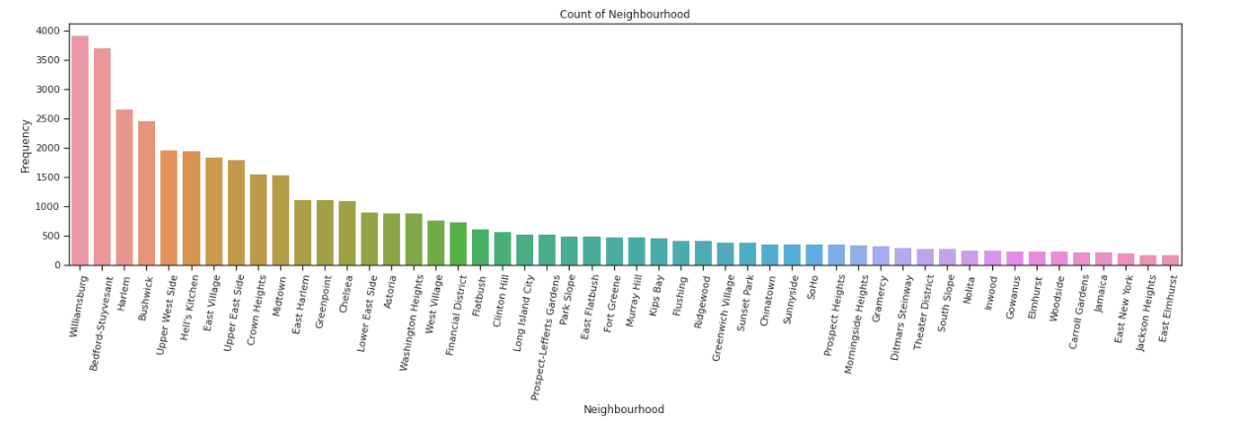

Count Of Neighbourhood :

Slide 16
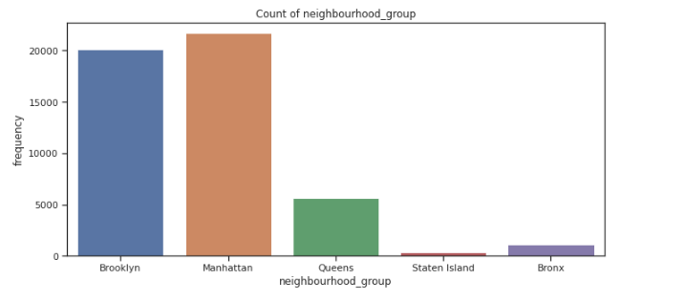
Count Of Neighbourhood Group :

Slide 17
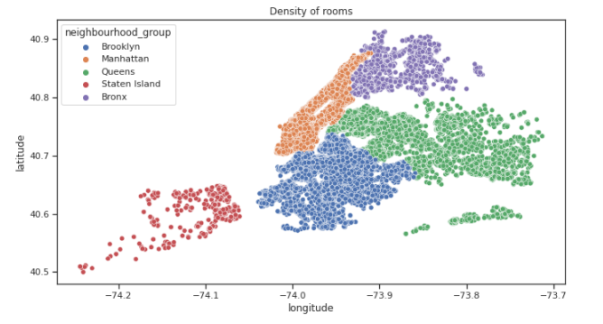
Longitude & Latitude

Slide 18

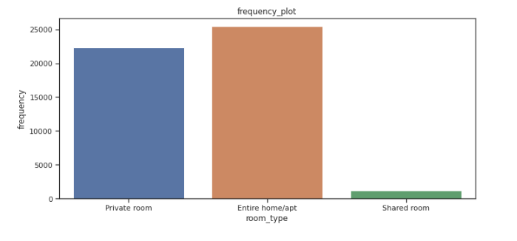
Room Type
Observations:
1.There are three types of rooms
2. Namely:
1.Private room
2.Entire home/apt room type
3.Shared room.
3.People mostly preferred to take
whole apartment on rent
followed by Private room.
4. very few people preferred to
have shared rooms.
We will try to categories the 'price' like cheep, affordable and expensive and then analyze the 'price' for 'room type' as per it.

Slide 19

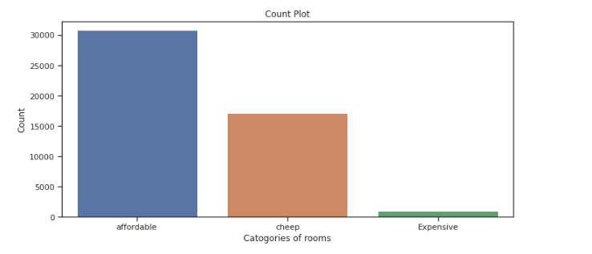
Check The Price Range
cheep (price range below or equal to 80$)
Affordable(for price range 80 to 500$)
Expensive(for price range more then 500$) so, it look like people have more interest in having "affordable" rooms/apartments rather then having cheep and expensive rooms.

Slide 20
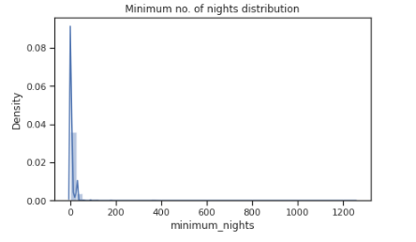
Minimum No Of Nights Distribution
Observations
1. Average booking is around 7 nights.
2. minimum booking is for 1 night.
3. max booking is for more then a year or we can say for few years.

Slide 21
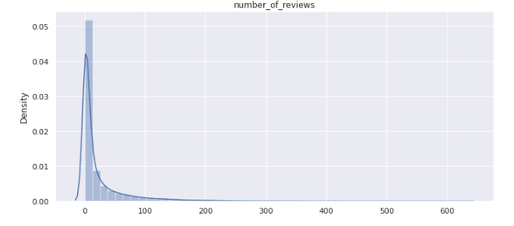
Number Of Reviews
Observations:
Number of reviews are highly dense form 0 to 100 reviews.
we can say that most of the rooms are not rated and those which are frequently occupied only those are rated.
maximum 629 times the particular room is rated.
Average rating is around 23.

Slide 22
column_no_9 calculated_host_listings_count
Most_common 50 host_listing_count
There is one host who is 327 time listed.
This is the corresponding host_id 219517861 who is having highest listing.
This is the corresponding host_id 15400695 who is having lowest listing.
_Review
max is 58 times the rating is given.
min is 0.
75% of data is for 1.5 time rating.

Slide 23
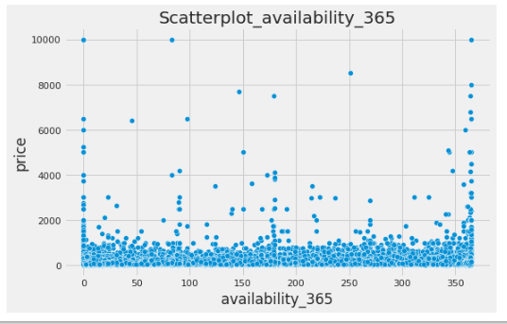
Availability_365
Observations:
1. From above plot we can see that most of the available rooms are in the prose range of 0 to 2000.
2. Very few are available for price above 2000$,this is quite oblivious that there are very few peoples
who prefer to have expensive rooms.

Slide 24

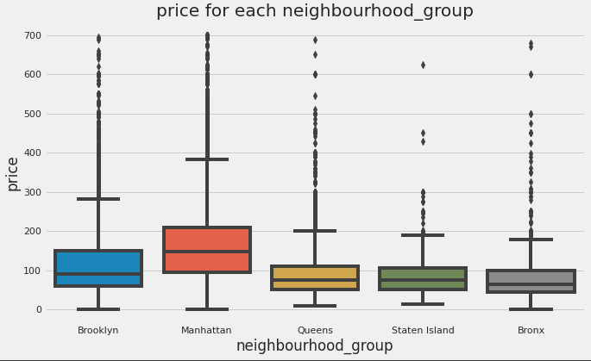
Lets find the relation between neighbourhood_group and price:

Slide 25
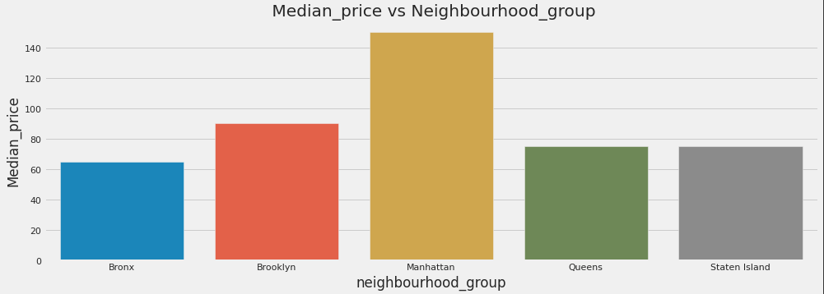
Relationship Between Neighborhoods Group And median price.

Slide 26
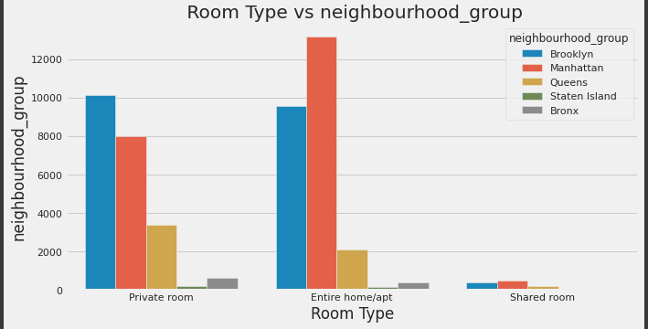
Relationship Between Room_Type And Neighbourhood_Group.

Slide 27
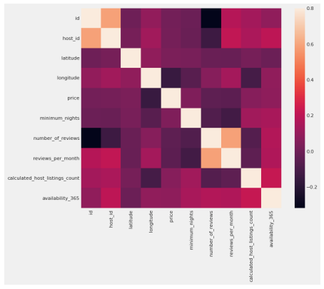
Heat-map shows the correlation between different feature
We an see that the correlation among the host_id to review per month and availability 360 and also there are correlation in the min_night to no/off listing count and availability 360. the price also show the sum correlation with availability 360 and host_listing_count.

Slide 28
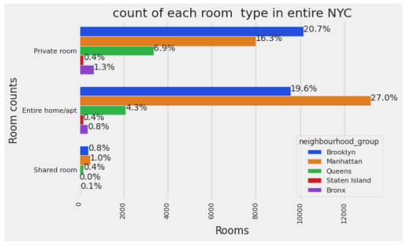
Observations Manhattan has more listed properties with Entire home/apt around 27% of total listed properties followed by Brooklyn with around 19.6%. Private rooms are more in Brooklyn as in 20.7% of the total listed properties followed by Manhattan with 16.3% of them. While 6.9% of private rooms are from Queens. Very few of the total listed have shared rooms listed on Airbnb where there's negligible or almost very rare shared rooms in Staten Island and Bronx. We can infer that Brooklyn, Queens, Bronx has more private room types while Manhattan which has the highest no of listings in entire NYC has more Entire home/apt room types.

Slide 29
Conclusion: We tried to put some light by performed the Extensive EDA for Airbnb dataset as always there is no end to EDA this can be extended in n- dimenssions and lots and lots of conclusion can be drawn from EDA this is where 80% of time is been spent by and Data Scientist.
Thankyou

